Slide 1






Patient care coordination by Team FiveCare: SyncMyCare

Slide 2








Team Members and Role
Dharsini Sri B
Business Analyst
Kaniska M
Jothika K
Developer
Tester
Team
FiveCare
Chanjhana Elango
Vijay Santhosh P
Developer
Tester

Slide 3
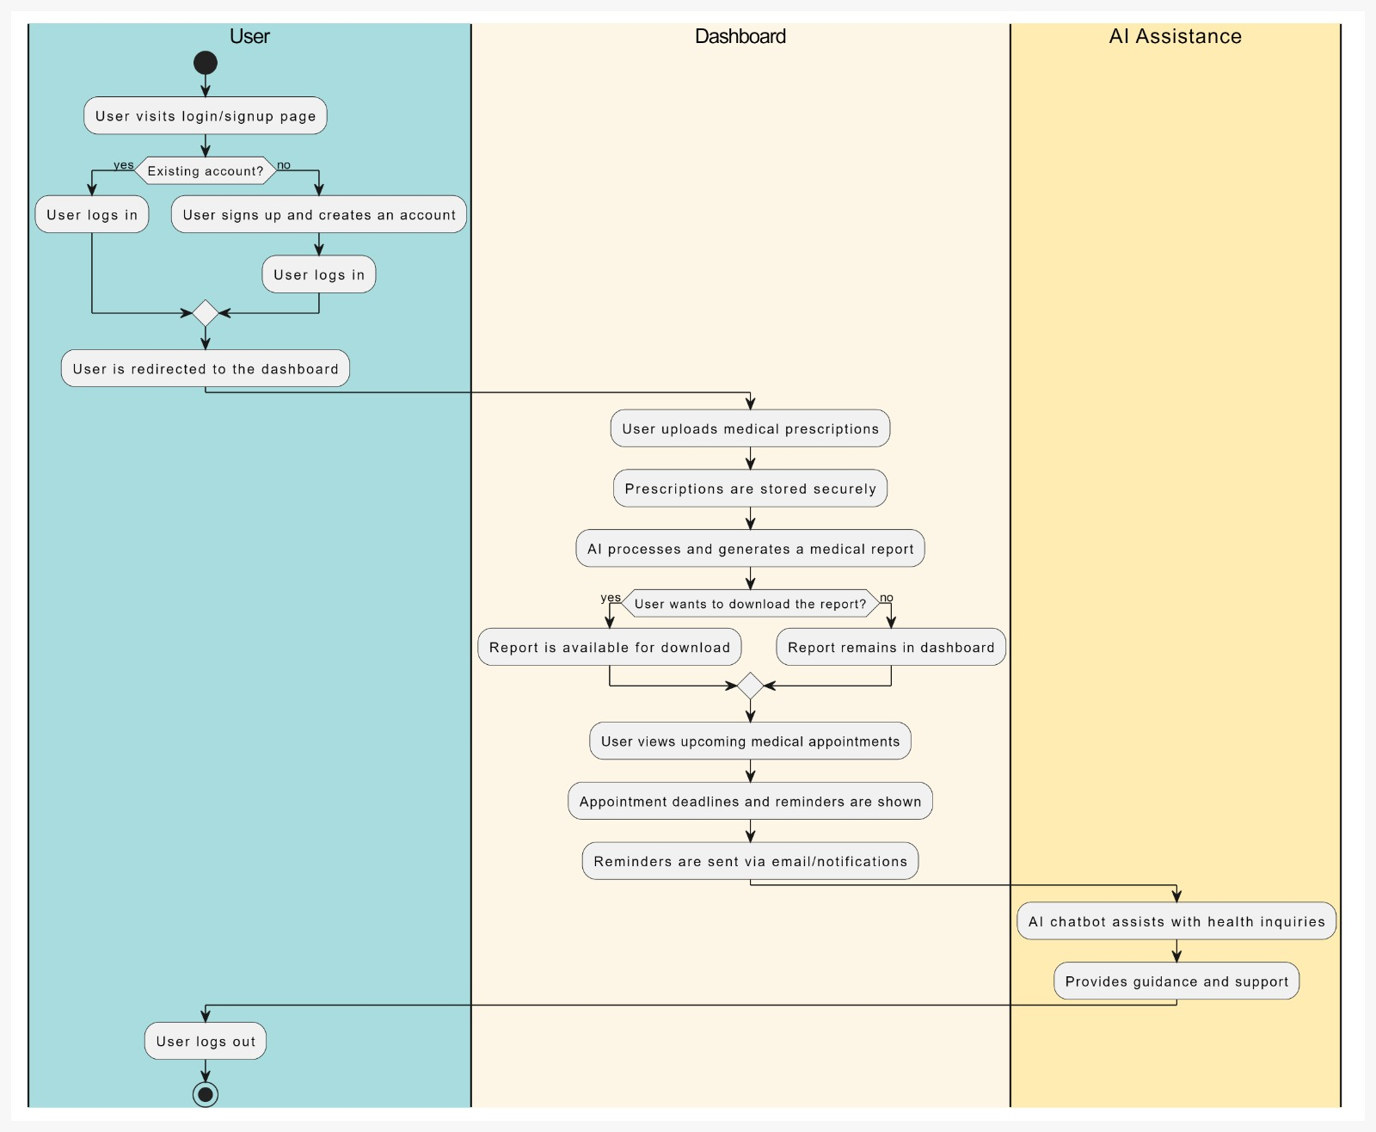
User Journey

Slide 4
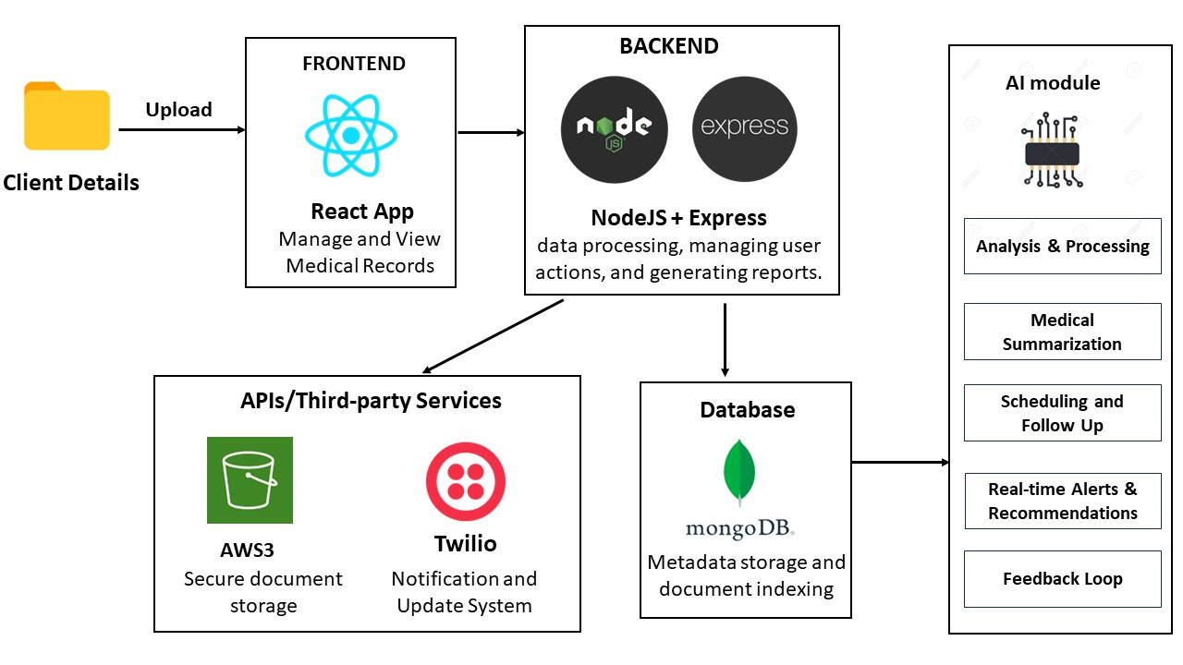
System Architecture

Slide 5
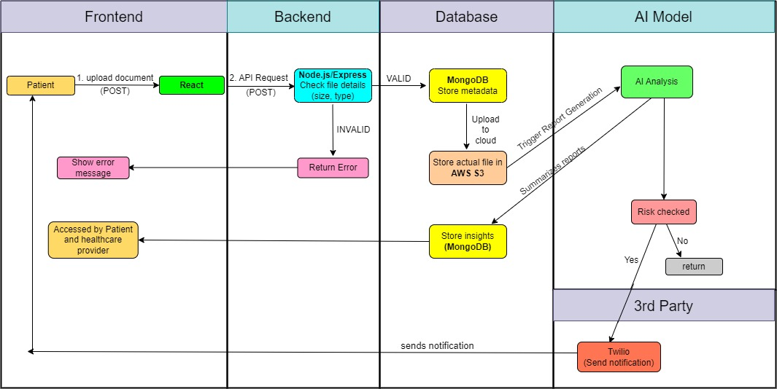
Data Flow

Slide 6
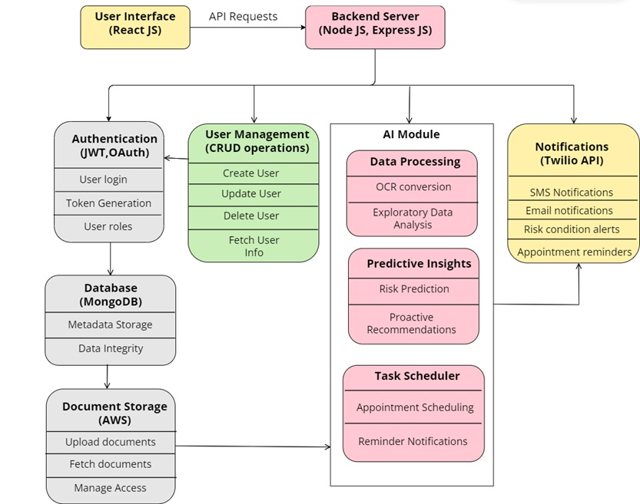
Backend Architecture

Slide 7
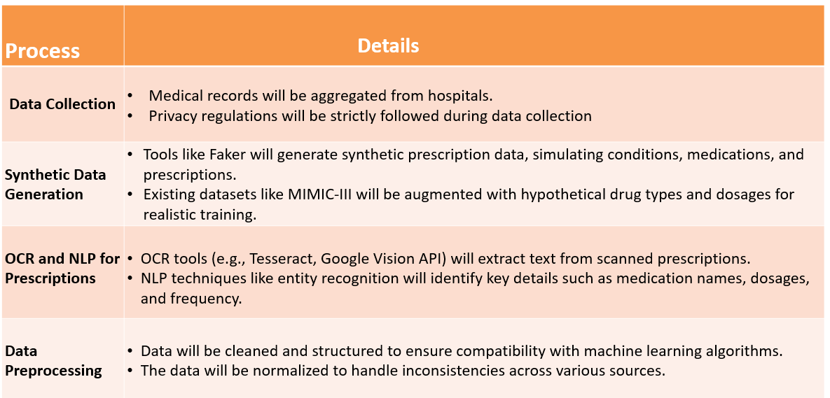
Dataset Creation and Sources

Slide 8
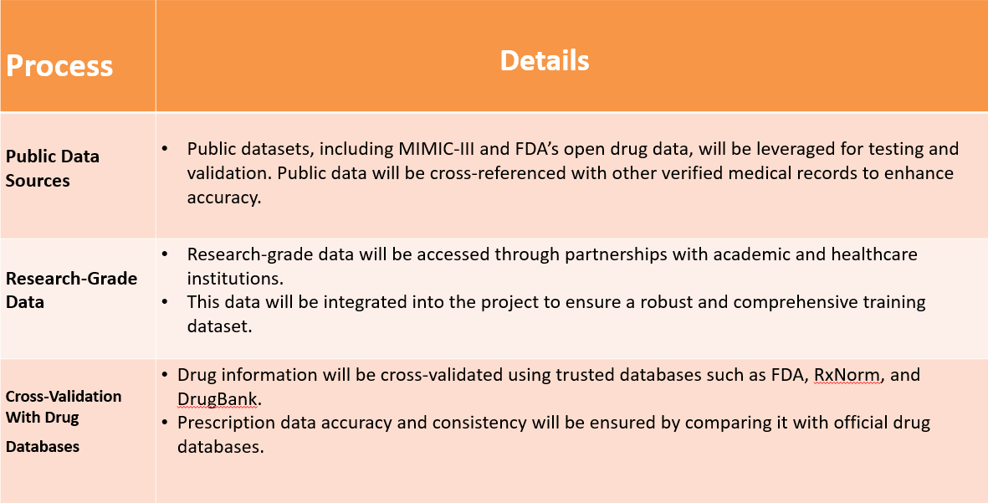
Dataset Creation and Sources

Slide 9
List of Personas
Patient without UMR :
Key Benefit/Issue : Lack of access to a centralized medical record system leads to incomplete medical information.
Impact : Increased risk of medical errors and adverse drug interactions, as the doctor cannot view the full medical history in real-time.
Experience/Workflow : Missed opportunity to check for drug interactions before prescribing new medications.
2. Patient With UMR :
Key Benefit/Issue : Centralized access to medical history ensures that all prescriptions, reports, and allergies are available to the doctor.
Impact : Reduced risk of drug interactions and medical errors. Saves time and avoids carrying multiple documents.
Experience/Workflow : UMR ensures that the patient’s health information is up-to-date and shared securely, enhancing the overall quality of care.

Slide 10
List of Personas
3. Doctor Using UMR :
Key Benefit/Issue : Saves time by providing immediate access to patient records and relevant health data.
Impact : Reduces the chances of medical errors, especially related to drug interactions, leading to better treatment outcomes.
Experience/Workflow : UMR improves workflow by allowing doctors to focus more on diagnosis and treatment, as all relevant information is in one place.
4. Healthcare Administrator :
Key Benefit/Issue : Centralized records make patient data management more efficient.
Impact : Reduces administrative burden and errors, leading to more efficient record- keeping.
Experience/Workflow : Scheduling and care coordination between departments become seamless as all necessary information is easily accessible.

Slide 11
List of Personas
5. Pharmacist :
Key Benefit/Issue : Access to a patient’s complete prescription history helps prevent harmful drug interactions.
Impact : Improved patient safety by reducing medication errors.
Experience/Workflow : Pharmacists can consult with doctors more effectively using clear, upto-date records of a patient’s medication and treatment history.

Slide 12
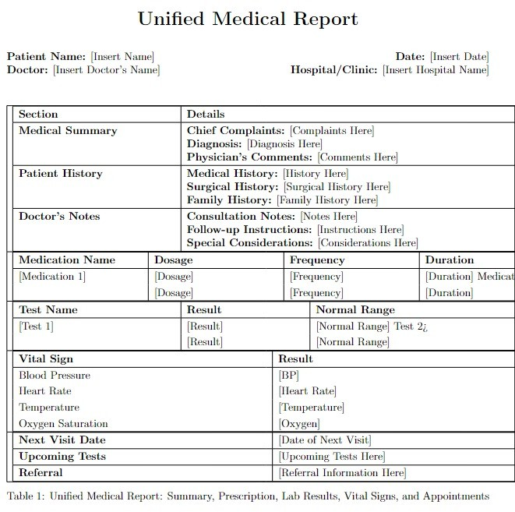
Unified Medical Report Format

Slide 13

Thank You

